Slide 1
Attacks
Dola Das
Assistant Professor
Dept. of CSE, KUET

Slide 2
Salami Attack
a technique by which Cyber-criminals steal money or resources a bit at a time
no noticeable difference in overall size
accumulates a considerable amount over a period of time
the essence of this method is the failure to detect the misappropriation.

Slide 3
Salami Attack
Types of Salami attacks:
  Salami Slicing: when attacker/hacker deduct an awfully touch of cash from each account.
  Penny Shaving: when the attackers/hacker steal money by using rounding to the closest within the transactions.
Prevention From Salami attack:
  by overseeing the weekly transactions and month-to-month bank statements
  financial institutions, like banks, should also update their security so that the attacker doesn’t become conversant

Slide 4
Denial of Service (DoS) Attack
A denial of service or DoS attack is used to tie up a website’s resources so that users who need to access the site cannot do so.
to force the shutdown of the targeted website, server or network.

Slide 5
Denial of Service (DoS) Attack
So, How do DoS attacks work?

Slide 6
Distributed Denial of Service (DDoS) Attack
the next step in the evolution of DoS attacks
use large numbers of compromised computers, as well as other electronic devices — such as webcams and smart televisions

Slide 7
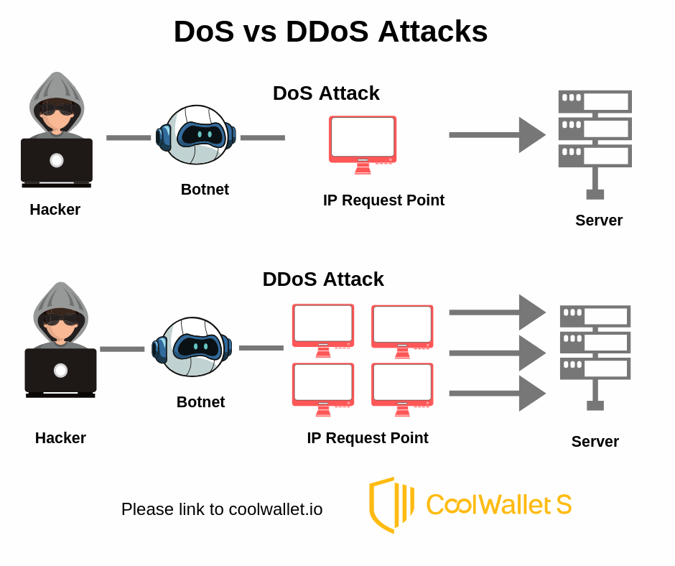
DoS and DDoS

Slide 8
Preventions
Get help recognizing attacks
Contact your internet service provider
Investigate black hole routing
Configure firewalls and routers

Slide 9
DHCP Spoofing Attack
DHCP spoofing is when a malicious actor sets up an alternate DHCP server on a network to provide false addressing and configuration information to clients.
If the rogue server responds first and the offer is accepted, there are a few incorrect pieces of information that could have negative impacts on clients and the network as a whole.

Slide 10
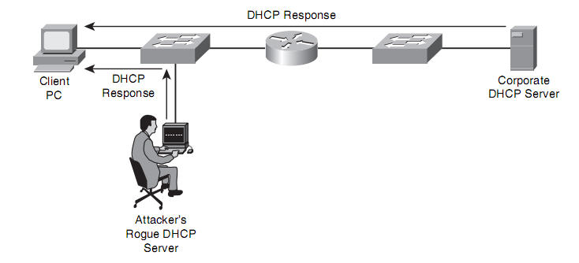
DHCP Spoofing Attack

Slide 11
DHCP Spoofing Attack
Impacts:
  could create a DoS attack by giving clients the incorrect Default Gateway, IP Address, Subnet Mask, or DNS server
  could create a Man-In-The-Middle attack by giving clients an alternate Default Gateway
  if their communication isn’t encrypted, the alternate Default Gateway could intercept their messages and gain information from them
  etc.

Slide 12
DHCP Spoofing Attack Prevention
All access ports that connect to end-users should be marked as untrusted
Once DHCP snooping is enabled, this is configured on all ports by default
  DHCP Snooping is a layer 2 security technology incorporated into the operating system of a capable network switch that drops DHCP traffic determined to be unacceptable.
  DHCP Snooping prevents unauthorized (rogue) DHCP servers offering IP addresses to DHCP clients.
Any DHCP Offer messages will be blocked on untrusted ports, preventing them from acting as a DHCP server
ports that connect to other network devices that are managed by the admin should be marked as trusted. These devices include routers, switches, and servers
But if anyone can get physical access, can change configurations.

Slide 13
Dictionary Attack
a systematic method of guessing a password by trying many common words
Hackers use this attack to gain access to online accounts, but also for file decryption – and that’s an even bigger problem

Slide 14
How does a dictionary attack work?
can be performed both online and offline
Online
  attacker repeatedly tries to log in or gain access
  works better if the hacker has a list of likely passwords
  If the attack takes too long, it might get noticed by a system administrator or the original user.
Offline
  no network limitations to how many times you can guess the password
  To do it, hackers need to get their hands on the password storage file from the system they want to access, so it’s more complicated than an online attack
  once they have the correct password, they will be able to log in without anyone noticing

Slide 15
Difference between a brute force attack and a dictionary attack
Brute force
  mostly rely on the computing power of the attacker’s computer
  a program also automatically enters combinations of letters, symbols, and numbers, but in this case, they are entirely random.
  Brute force attacks can also be performed online and offline.
Dictionary attack
  1,022,000 words in the English language and numbers 0-9, 218,340,105,584,896 eight-character passwords.
  In this case, a dictionary attack is much more likely to succeed, given that the password will be a simple English word.
  A basic brute force attack would take much more time and is less likely to be successful.
Dictionary attacks are brute force attacks in nature. The only difference is that dictionary attacks are more efficient – they usually don’t need to try as many combinations to succeed. However, if the password is a truly unique one, a dictionary attack won’t work. In that case, using brute force is the only option.

Slide 16
How to avoid a password dictionary attack?
use captchas,
implement mandatory two-factor authentication,
limit how many times one user can attempt to log in before their account is locked

Slide 17
Rainbow Table Attack
a password cracking method that uses a special table (a “rainbow table”) to crack the password hashes in a database
The rainbow table itself refers to a precomputed table that contains the password hash value for each plain text character used during the authentication process.
If hackers gain access to the list of password hashes, they can crack all passwords very quickly with a rainbow table.

Slide 18
Rainbow Table Attack
The prevalence of rainbow table attacks has dramatically decreased due to a technique known as “salting.”
Salting is a modern technique used to thwart rainbow table attacks.
It involves adding an extra random value to every hashed password to create a different hash value.

Slide 19
How a Rainbow Table Attack Works
Hackers must first gain access to leaked hashes in order to carry out rainbow table attacks.
The password database itself might be poorly secured, or they may have gained access to the Active Directory.
Others gain access through phishing techniques of those that might have access to the password database.
On top of all these techniques, there are already millions and millions of leaked password hashes on the dark web that are available to hackers.

Slide 20
How to Protect Against a Rainbow Table Attack
Eliminate passwords
Use salting
Use biometrics
Monitor your servers.
Don’t use outdated hashing algorithms.

Slide 21
Thank you!!

